Slide 1
Numerical Experiments of Solving Moderate-Velocity Flow Field Using a Hybrid CFD-MD Approach
ASME-JSME-KSME Joint Fluids Engineering Conference 2011
Soon-Heum Ko^{*,1}, Nayong Kim² and Shantenu Jha²
¹National Supercomputing Centre, Linköping, Sweden
²Center for Computation and Technology, Louisiana, USA
2011-07-27

Slide 2
Outline
Introduction
Accuracy of a Hybrid CFD-MD Approach
Suppression of the Statistical Noise
Numerical Simulations
Concluding Remarks

Slide 3
Introduction
NSC – National Supercomputing Centre in Sweden
Motivation for a Hybrid Simulation
Numerical Issues
Agenda for Today’s Presentation

Slide 4
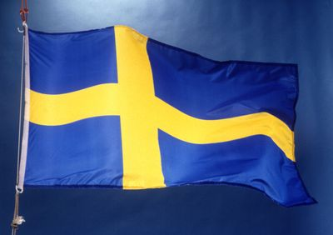
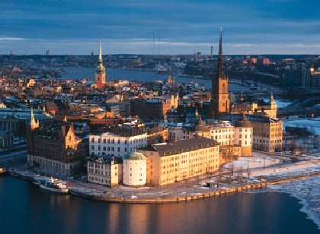
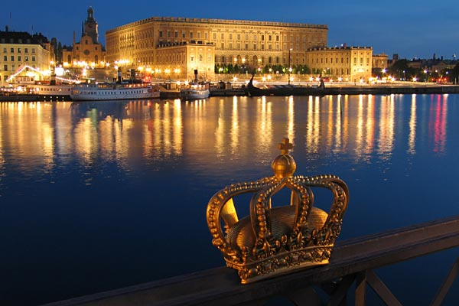
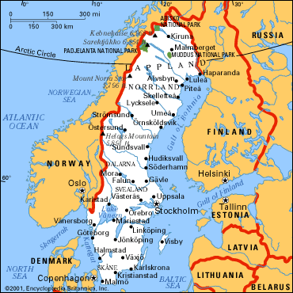
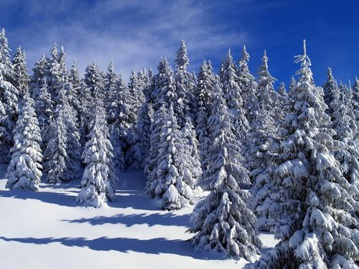
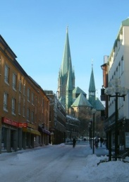
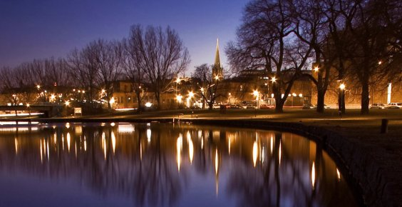
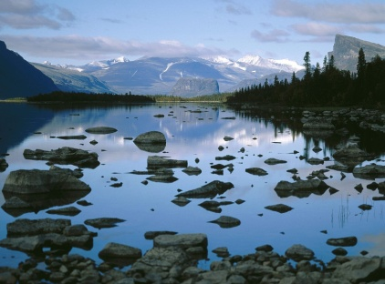


NSC – National Supercomputing Centre
NSC is located in the Linköping University

Slide 5
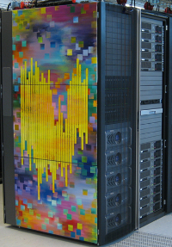
NSC – National Supercomputing Centre
    Founded in 1989 (originated from the collaboration with Saab)
    One of the largest academic supercomputing centres in Sweden
      SNIC: Swedish National Infrastructure for Computing
      > 150 million core hours serviced to academic and company partners around Sweden
    Competence in hardware, software & e-science
      3 main public clusters with 13480 cores (123 TeraFlops) in total
      + 4 dedicated systems to specific research groups / companies
      ~ 2.1 PB central storage disk + ~3.0 PB tape robot
      SeRC: Swedish e-Science Research Centre
    27 personnel now, gradually increasing
      4 General Coordinator
      14 System Administrator
      9 Application Experts
Neolith

Slide 6
Motivation
A Hybrid CFD-MD Approach
  Solves the bulk flow region by the computational fluid dynamics (CFD) technique and applies the molecular dynamics (MD) methodology to acquire higher-resolution near the solid-fluid interface
CFD
Macroscopic flow
Geometrically complex
fluidic system
MD
Microscopic flow
Able to describe
intermolecular effect
Empirical boundary modeling
for accurate wall boundary
Excessive computational cost
on solving real-scale systems
A Hybrid CFD-MD Approach

Slide 7
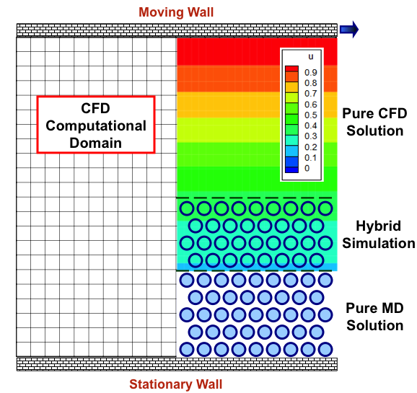

Numerical Issues
Hybrid Computational Domain
External
Force
Forces to maintain
system’s ensemble
Accuracy of
a continuum solver
Imposing continuum
solution to higher
DOF domain
Buffer
CFD
to
MD
Performance of coupled simulation:
Co-scheduling
Load balancing
Particles following
the continuum solution
Accuracy of
a particle
solver
Buffer
Minimizing
the locality of
sampled profile
MD
to
CFD
Sampled molecular properties imposed

Slide 8
Agenda
How to Solve Moderate-Velocity Flow Field
by a Hybrid CFD-MD Approach
  Previous studies focus on solving O(100) m/s flow field
  in O(-8) meter domain
    Excessive noise in averaged molecular properties /
    Very UNREALISTIC
  Reducing the sampling noise
    Delicated determination of coupling parameters *
    Sampling multiple replicas *
    Interpolating over multiple spatial/temporal samples
  * overlaps with the article in preparation to the ’Journal of Computational Science’

Slide 9
Accuracy of a Hybrid CFD-MD Approach
Baseline CFD and MD Modeling
Spatial Accuracy of Hybrid Boundary Conditions

Slide 10
CFD Solver
In-house Continuum Hydrodynamics Code
  Incompressible Navier-Stokes Equations
  Artificial Compressibility
  Osher’s FDS (Convention) / Central Differencing (Diffusion)
  LU-SGS (Lower Upper Symmetric Gauss Seidel) /
  Dual Time Stepping for Unsteady Flow Simulation

Slide 11
MD Solver
LAMMPS (Large-scale Atomistic/Molecular Massive Parallel Simulator) Package
  Newton’s 2nd Law
  Van der Waals Force via Lennard-Jones Potential
    Cut-off Length: 2.2 σ
  Verlet Algorithm for Time Integration

Slide 12
Continuum-to-Particle Hybrid BC
How to Impose the Continuum Solution into the Atomic Domain without Harming Particles’ DOF
  Alternating Schwarz method (Hadjiconstantinou et al.)
  The direct flux exchange approach (Flekkoy et al.)
  Constrained Lagrangian dynamics (O’Connell et al.)

Slide 13
Continuum-to-Particle Hybrid BC (Cont’d)
Constrained Lagrangian Dynamics
  Constrained MD Equation
    Drive multi-DOF molecular motion following the continuum solution
  External Force Equation
    On outmost MD layer
    Holding particles within MD simulation domain (considering the ensemble of molecular system)

Slide 14
Particle-to-Continuum Hybrid BC
How to Suppress the Fluctuating Phenomenon (‘Sampling Noise’ or ‘Statistical Error’) of Atomic Samples
  Sampling molecular properties over a finite spatial/temporal range
    Very sensitive to the coupling condition

Slide 15
Suppression of the Statistical Noise
Characteristics of the Sampling Noise
Determination of Coupling Parameters
Sampling of Multiple Replicas
Interpolation in Space and Time

Slide 16
Characteristics of the Sampling Noise
  Sampled MD properties over a finite spatial/temporal range do not match the analytic/continuum solution (denoted as the ‘sampling noise’ or ‘statistical error’)
    Noise is described as the function of number of particles participating in sampling process
    The above general expression is incomplete in accurately predicting the sampling noise in a nano-scale fluid system
      Interaction with solid material
      Geometric configuration
      Characteristics of fluid particle

Slide 17
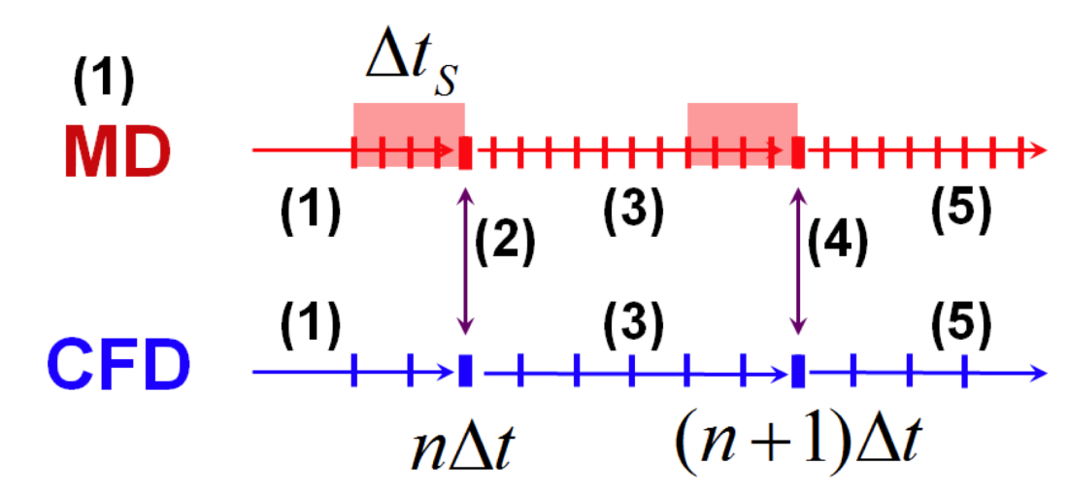
Coupling Parameters
  Parameters which affect the scale of sampling noise
  Conditions determined by measuring the sampling noise of the stationary (zero-velocity) molecular dynamic solution
Moving wall
External Force
CFD to MD
time
MD to CFD
How often the sampled property is exchanged (Sampling Interval)
How long the sampling is performed
(Sampling Duration)
Stationary wall
Where the sampling is performed (Layer Position)
How many particles participate in sampling
(Layer Size)

Slide 18
Sampling Multiple Replicas
Conduct multiple replica simulations (different Boltzmann-Maxwellian distribution of particles) and sample these results
  Computationally easier to conduct the simulation
    Easily get allocations for multiple smaller jobs
    (Solution is not identical to the result by an individual simulation on a larger system domain)
  Slight benefit on parallel performance
    512(Core)*1(Job) VS 128(Core)*4(Job) in Weak Scale
    (Computational cost itself does not change)
  Number of samples to get a converged solution
    Apply the relation of to the periodic direction

Slide 19
Interpolation of Multiple Samples (Curve Fitting)
MD Domain
CFD Domain
...
v_{j+2}
v_{j+1}
v_{j}
v_{j-1}
v_{j-2}
...
Spatial interpolation to impose V_{hybrid} = f(v_{j-N}, ..., v_{j+N})

Slide 20
Interpolation of Multiple Samples (Curve Fitting)
Sampled molecular property at each time interval
Interpolation function
V(t)
time
t-NΔt
t
t+Δt
Temporal interpolation to impose V(t to t+Δt)

Slide 21
Numerical Experiments
Determining the Coupling Conditions
Verification
Moderate-Velocity Flow Simulation

Slide 22
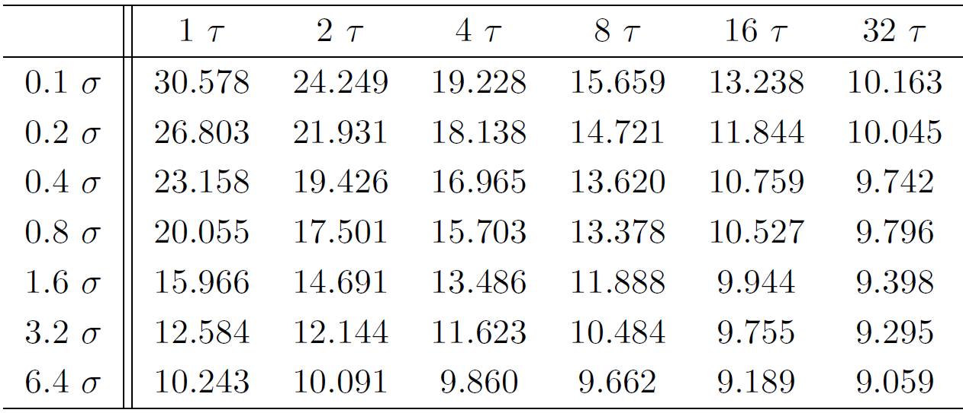
Geometry and Coupling Parameters
A transient Couette Flow
  Liquid Argon
    Characteristic time scale τ = 2.2 × 10⁻¹² sec
  Nano-scale channel (52 σ ≈ 176Å)
  Coupling Parameters
    Sampling duration =
    Sampling interval = 10 τ
    Layer size = 2 σ
    Layer position = 10 σ
    above the bottom wall
    System’s length = 140 σ
      Solution’s noise within 5% of
      the macroscopic velocity
Sampling noise in the molecular domain at rest

Slide 23
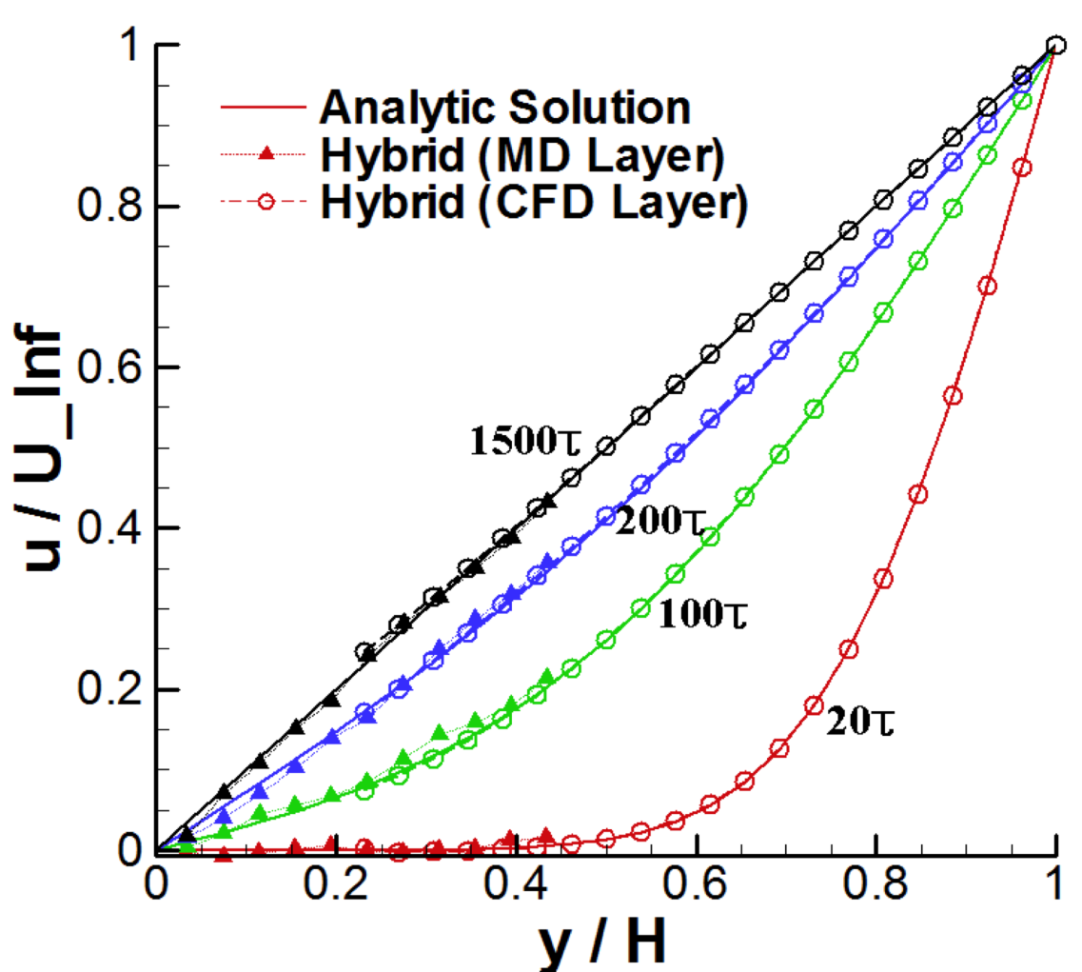
Validation / Verification
A Transient Couette Flow
  Velocity of upper plate = 1 σ / τ (≈155m/s)

Slide 24
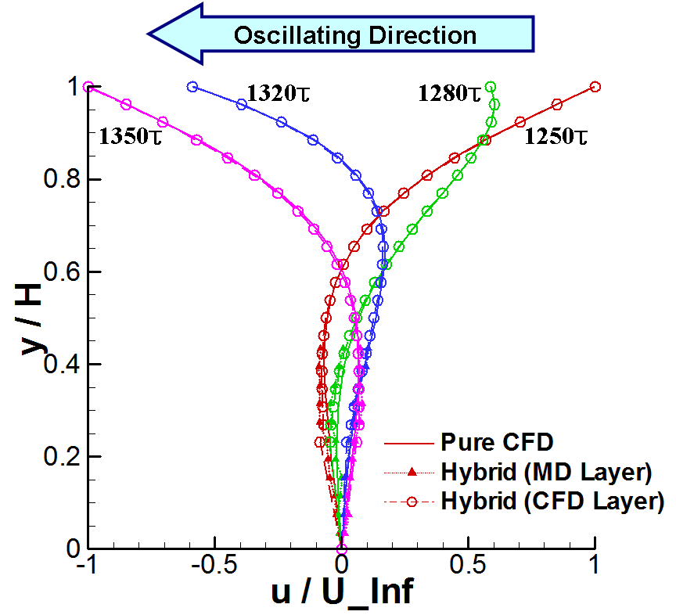
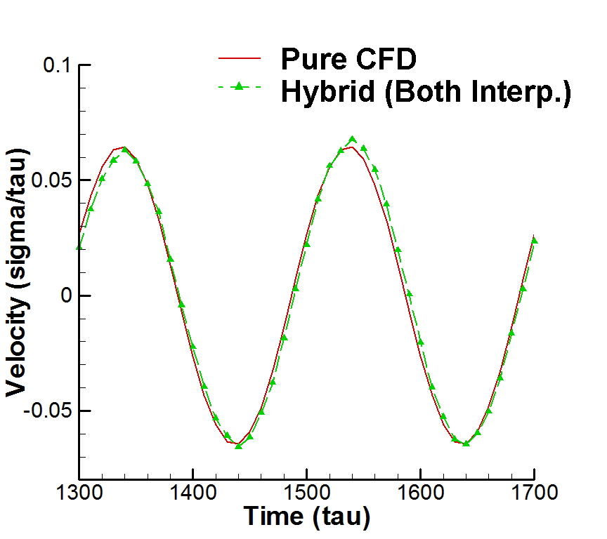
Validation / Verification
Oscillating Boundary Problem
  Upper plate oscillating with period = 200 τ
    Solution is noisier due to the lower macroscopic velocity at the sampling layer

Slide 25
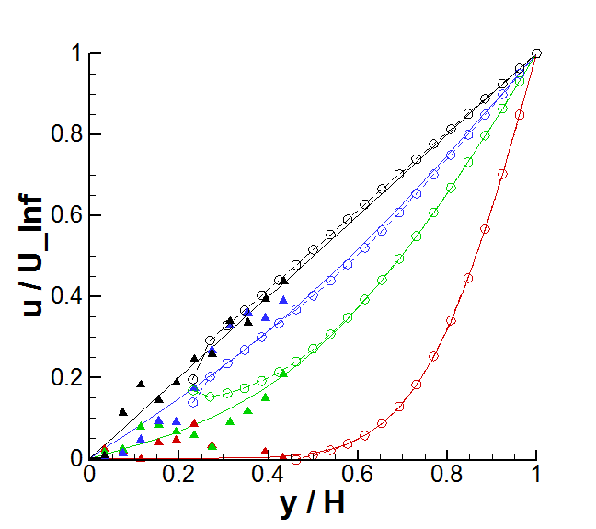
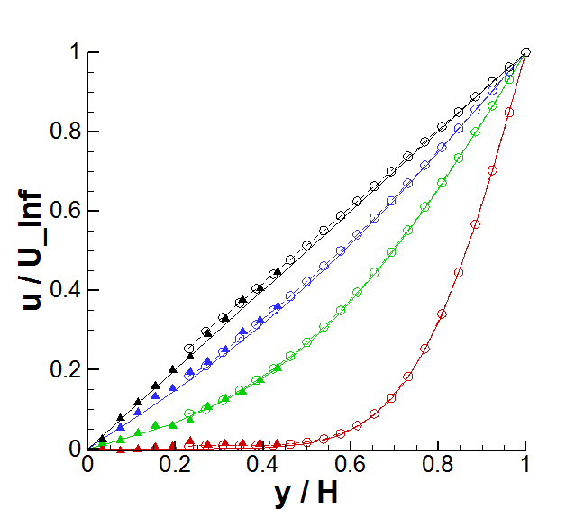
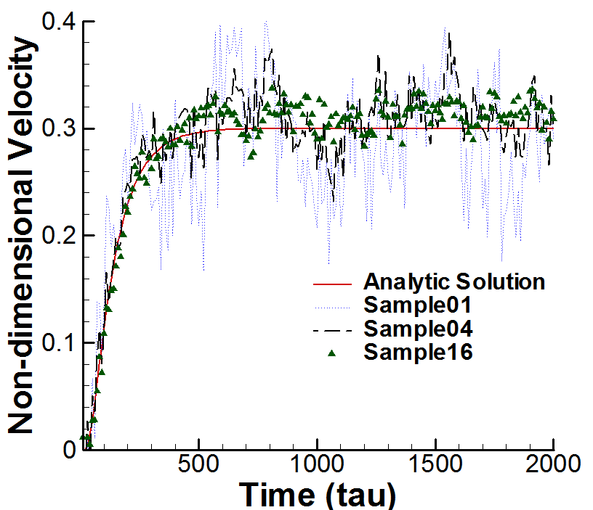
Moderate-Velocity Flow Simulations
Sampling Multiple Replicas
  Upper Plate Velocity of 0.25 σ / τ (≈39 m/s)
Individual Solution
Temporal History of Velocity Change
(In the middle of hybrid region)
16 Samples

Slide 26
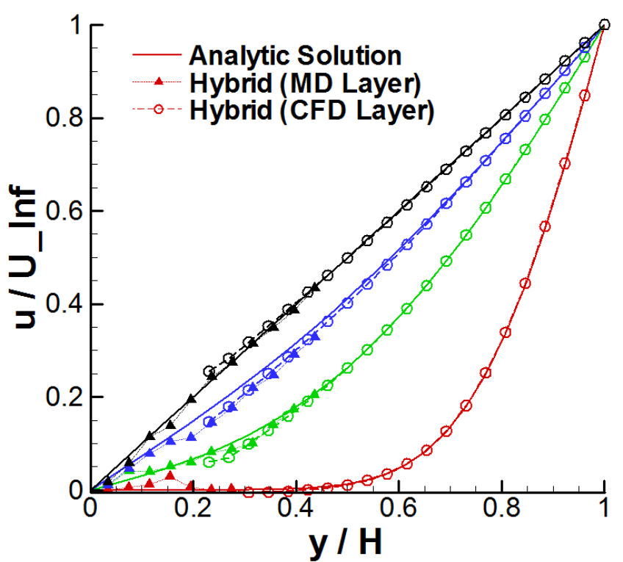
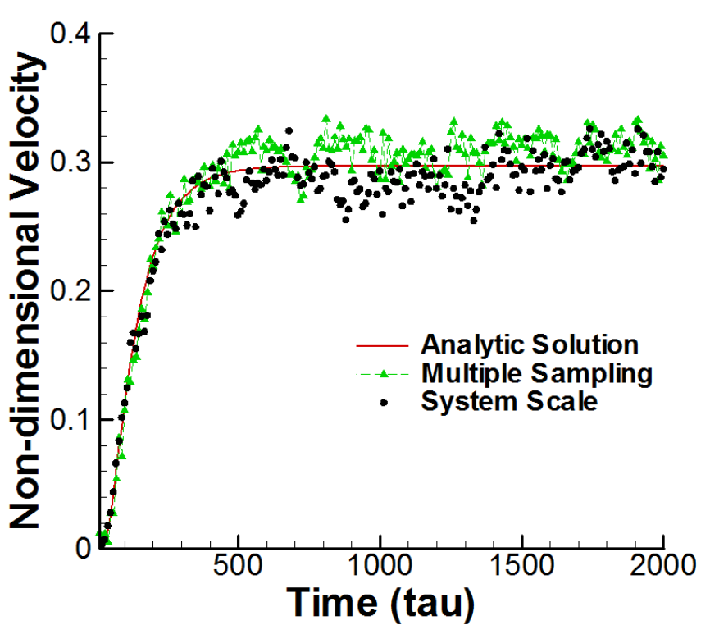
Moderate-Velocity Flow Simulation
16 Replicas VS 16L Domain
Solution with 16L in Periodic Direction
Temporal History of Velocity Change
(In the middle of hybrid region)

Slide 27
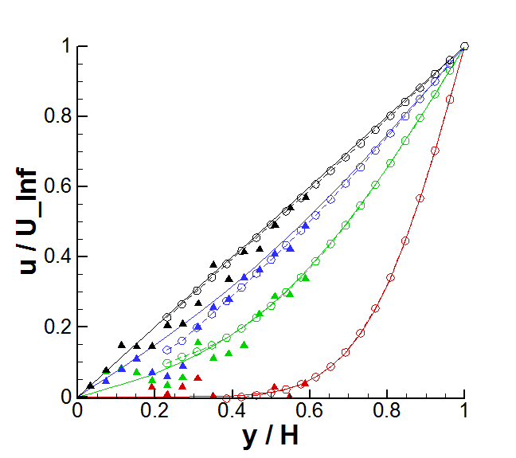
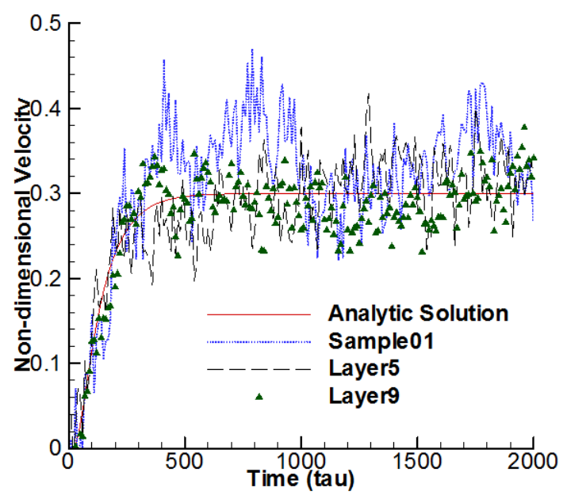
Moderate-Velocity Flow Simulation
Multi-point Interpolation in Space
Averaging 9 Vertical Layers
Temporal History of Velocity Change
(In the middle of hybrid region)

Slide 28
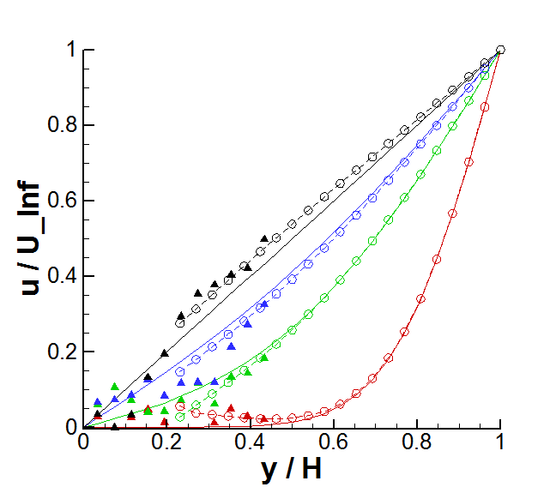
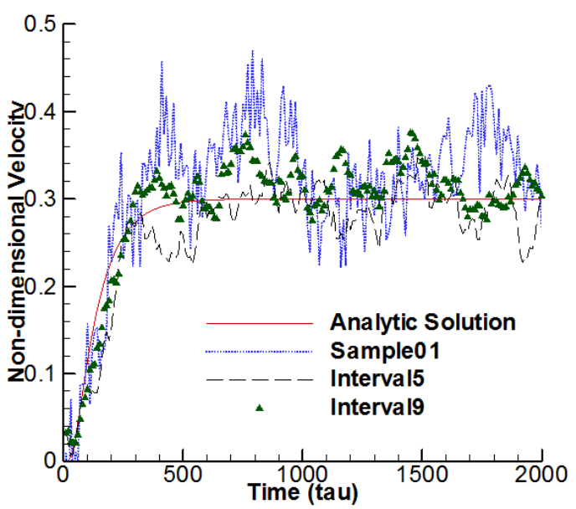
Moderate-Velocity Flow Simulation
Multi-point Interpolation in Time
Linear Fitting of 10 Previous Solutions
Temporal History of Velocity Change
(In the middle of hybrid region)

Slide 29
Moderate-Velocity Flow Simulation
Multi-point Interpolation in Time and Space
  (at 0.1 and 0.25)

Slide 30
Concluding Remarks
Concluding Remarks

Slide 31
Concluding Remarks
  A hybrid CFD-MD approach is a powerful tool for acquiring higher-resolution solution near the solid interface within
  the acceptable computational cost
  For the accurate solution,
    Accuracy of individual MD and CFD solvers
    Spatial accuracy on hybrid boundaries (Hybrid schemes for molecular domain; Suppressing sampling noise)
  should be provided

Slide 32
Concluding Remarks
  Researches to suppress the excessive sampling noise
    Determining optimal coupling parameters
    Sampling multiple replicas
    Interpolation on space and time
  Nano-scale flow simulations on
    A sudden-start Couette flow and oscillating boundary problem for the validation/verification
    Moderate-velocity flow simulations
      Replica sampling
      Spatial/temporal interpolation

Slide 33
Appendix
Mass Conservation in Artificial Compressibility Formulation
Solutions with 0.1 Non-dimensional Velocity

Slide 34
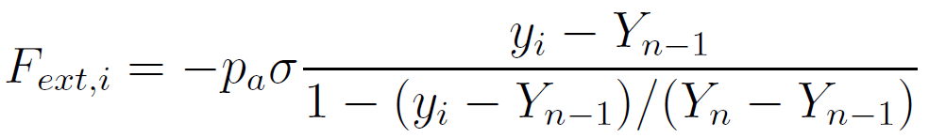
Appendix
Mass Conservation
  Determining the origin of the external force function
    The border of molecular domain < Equilibrium point
    < outside the domain
F
External
Force
F
y
F
Buffer
y
y
CFD
to
MD
Buffer
MD
to
CFD

Slide 35
Appendix
Mass Conservation
  Remedy
    Refined force field design by Werder et al (2005)
      Complicated model with case-specific coefficients
    Particle in the upper buffer layer is stretched to vertical direction according to the continuum density solution and force function assists on reserving the system’s ensemble
      ρ_{CFD} is acquired by the relation between artificial pressure and real density:
      Likewise, artificial pressure at MDtoCFD boundary is computed as:

Slide 36
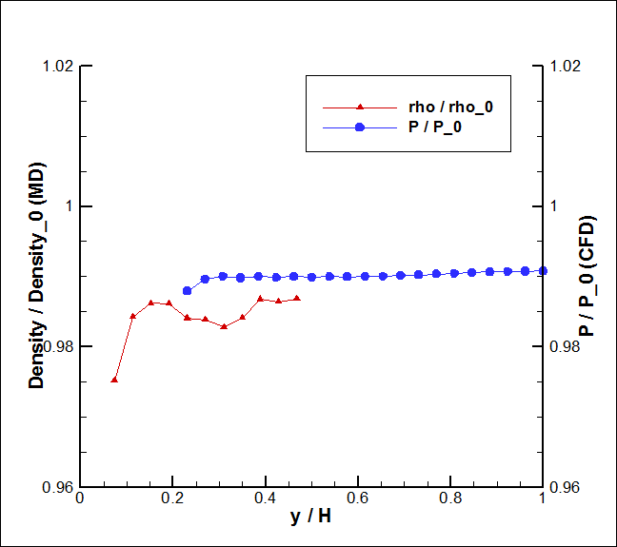
Appendix
Mass Conservation
  Solution
    The relation between density and artificial pressure:

Slide 37
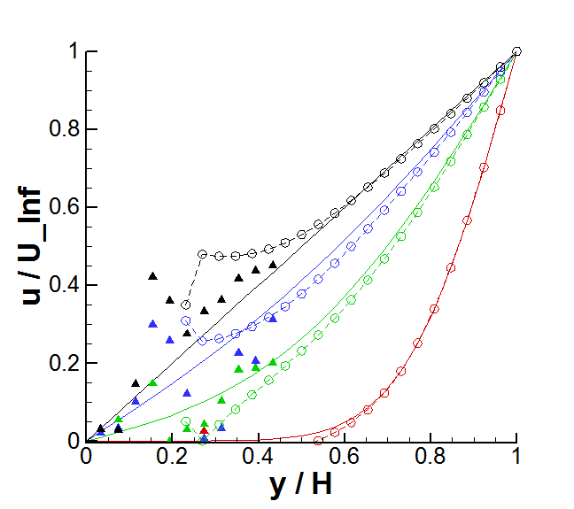
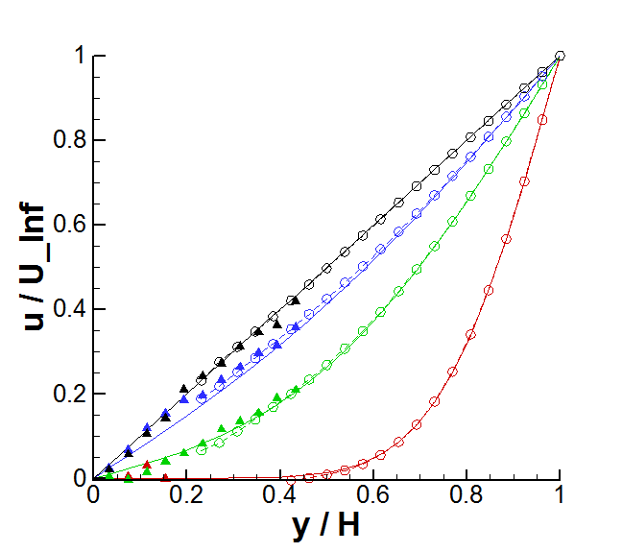
Appendix
Upper Plate Velocity of 0.1 σ / τ (≈15 m/s)
Individual Solution
32 Samples

