Slide 1
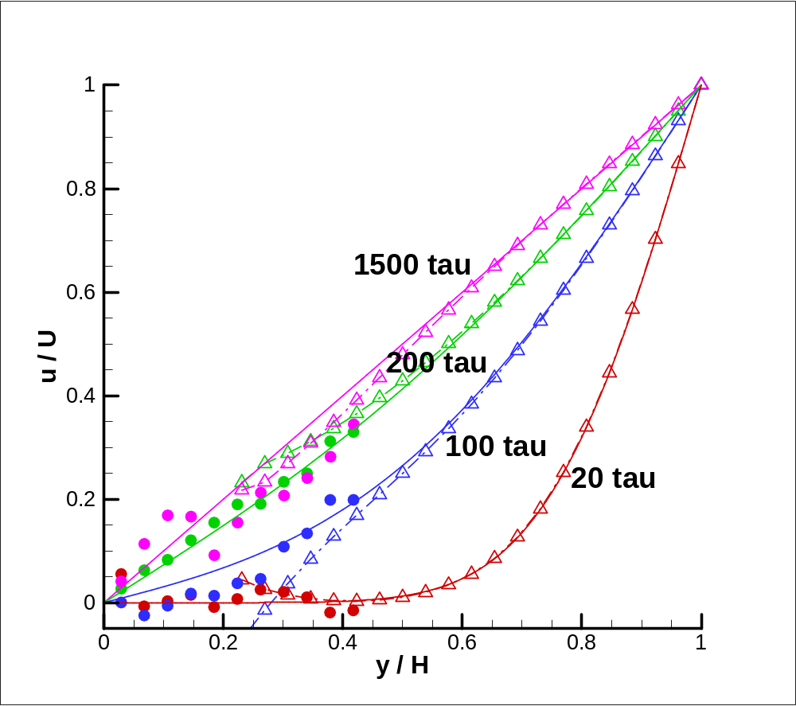
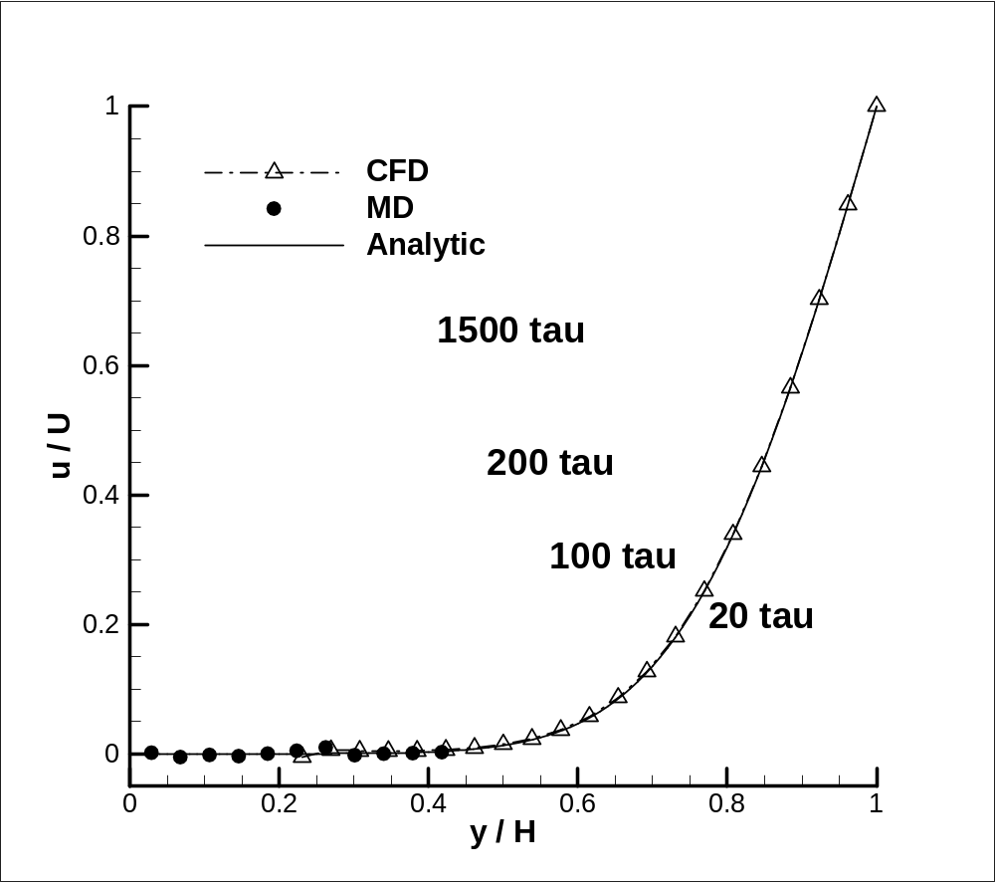
MultiReplica 01

Slide 2
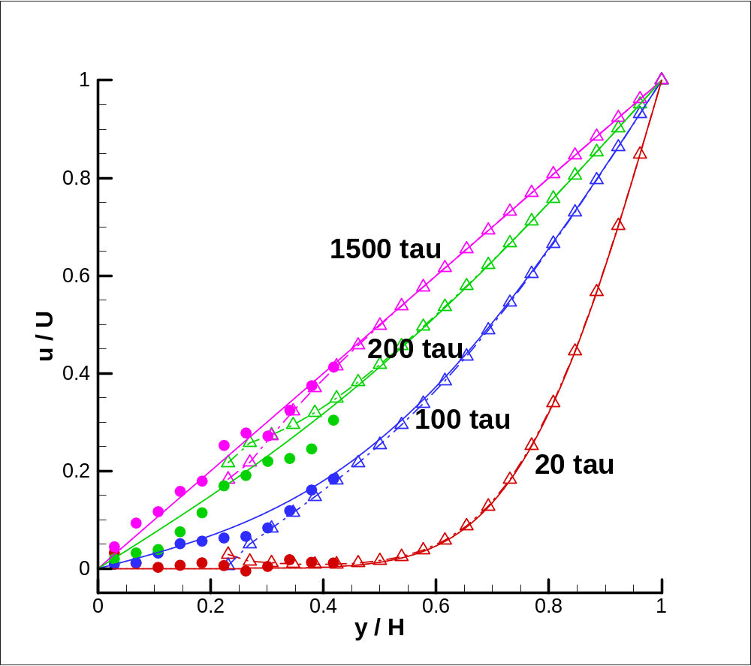
MultiReplica 04

Slide 3

MultiReplica 16

Slide 4
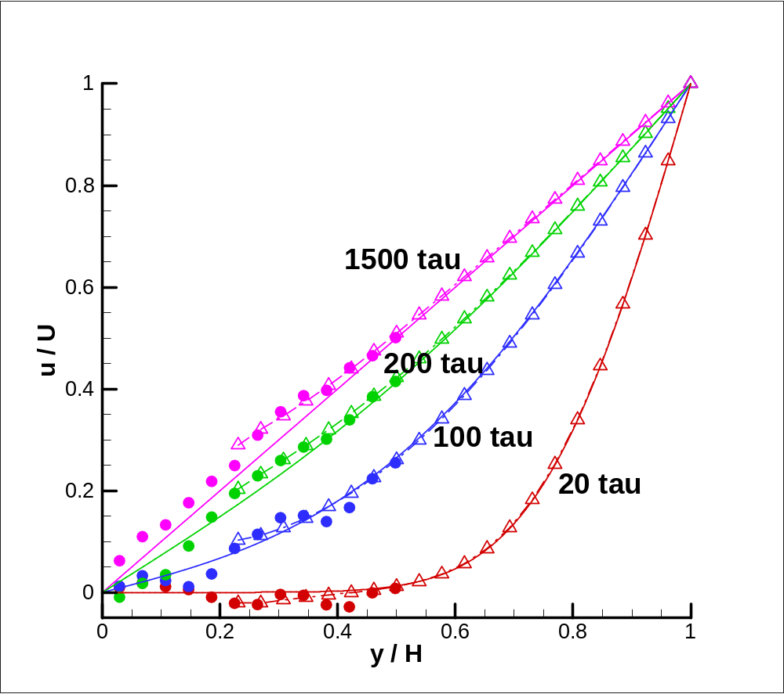
Sp5 4

Slide 5

Sp5 16

Slide 6
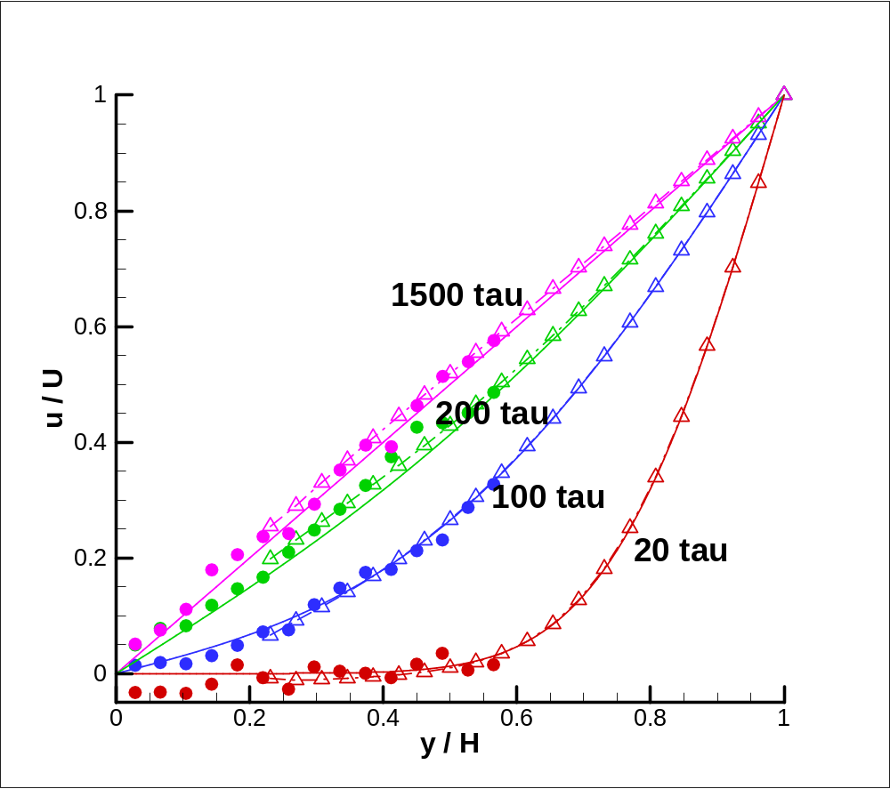
Sp9 4

Slide 7

Sp9 16

Slide 8
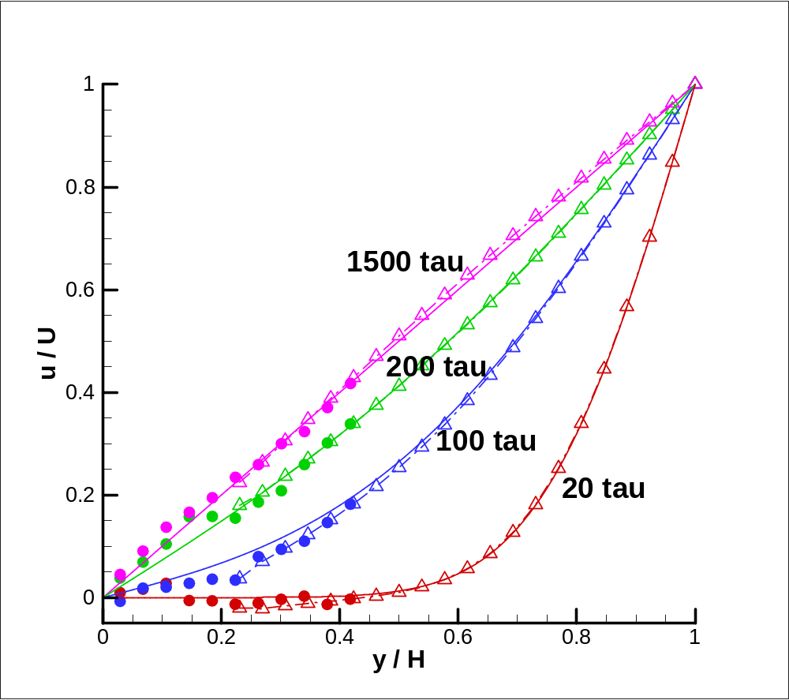
T5 4

Slide 9
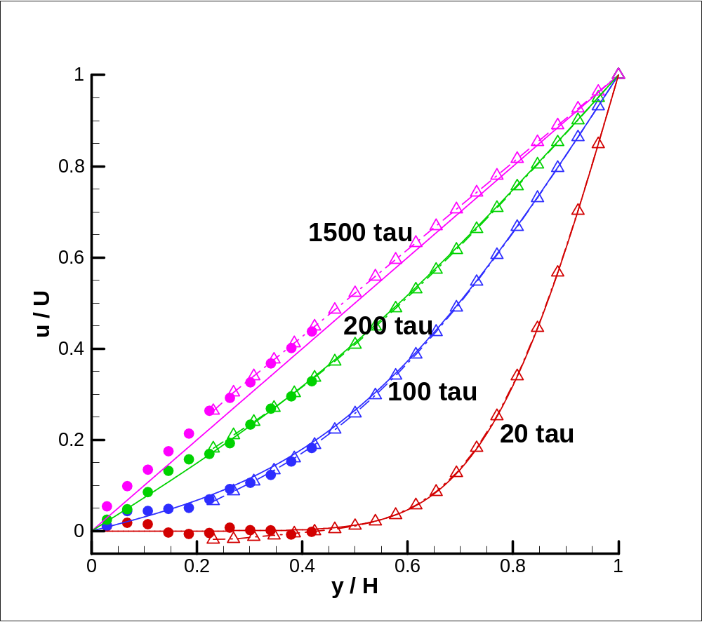
T5 16

Slide 10

T9 4

Slide 11

T9 16

Slide 12
CFD Domain
External Force
Buffer
CFDtoMD
Hybrid Region
Buffer
MDtoCFD
h
MD Domain
H₀
Solid Obstacle
L

Slide 13
Velocity
CFD Solution
Pure MD
Hybrid
Linear Regression of MD Samples
H₀
h
: MD Solution
Distance from Wall

Slide 14
Velocity
Pure MD
Hybrid
CFD Solution
Linear Regression of MD Samples
H₀
h
h
: MD Solution
Distance from Wall

Slide 15
Velocity
dt = dt_{s}
Linear Regression of MD Samples
: CFD Boundary Condition
: MD Sample
Physical Time

Slide 16
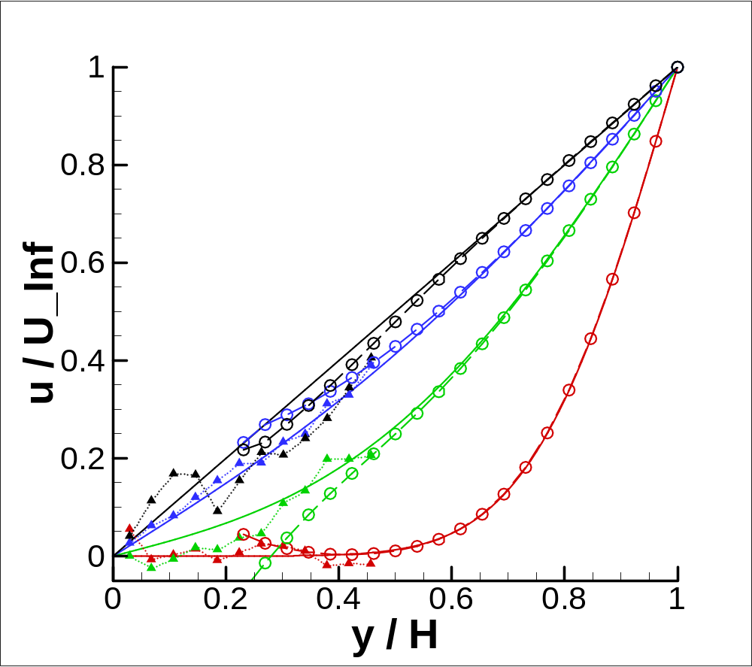
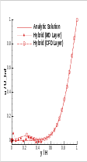
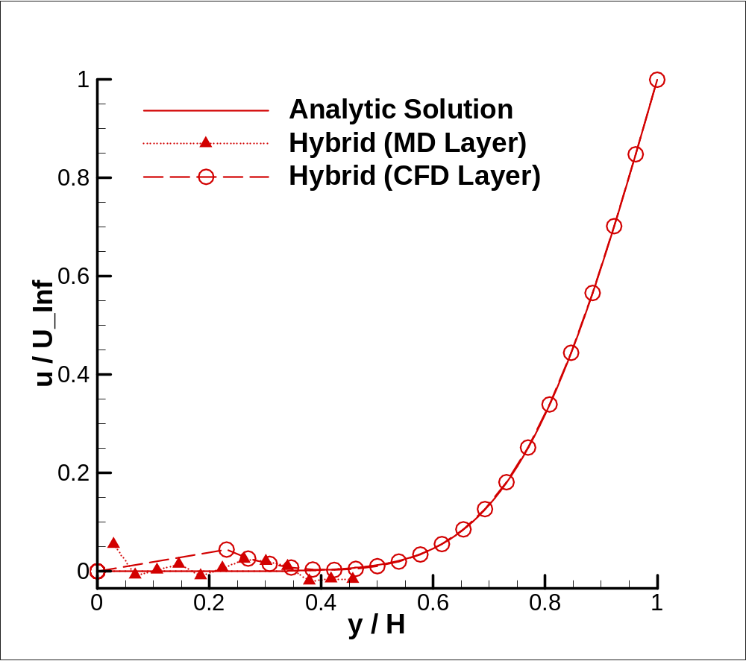
Org
1500τ
200τ
100τ
20τ

Slide 17
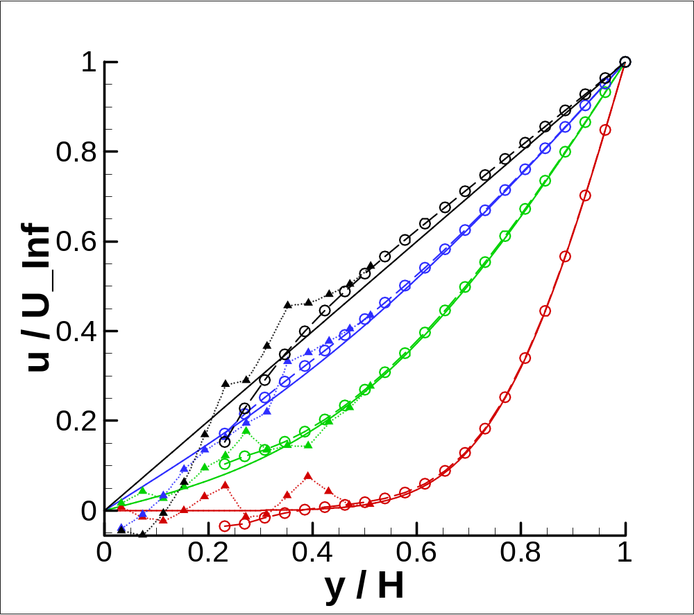
s5
1500τ
200τ
100τ
20τ

Slide 18
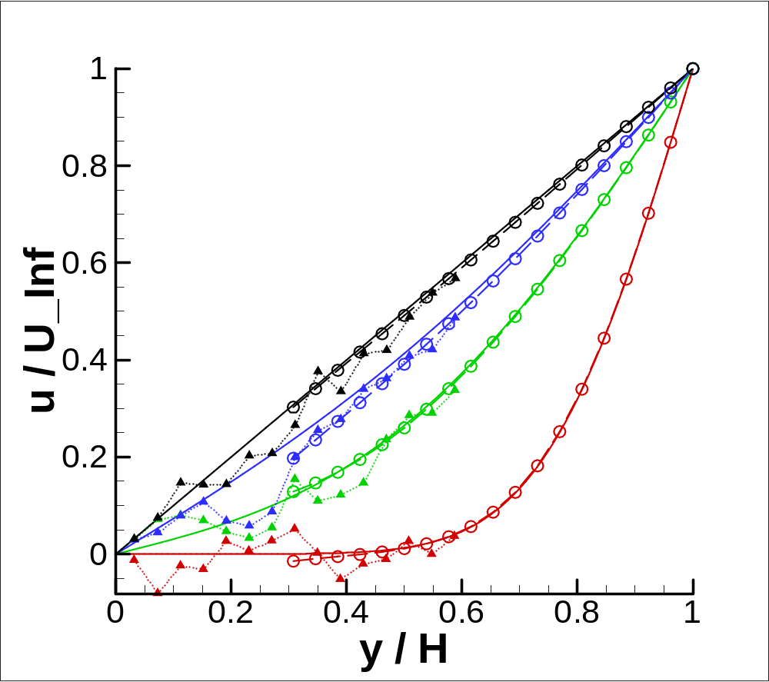
s9
1500τ
200τ
100τ
20τ

Slide 19
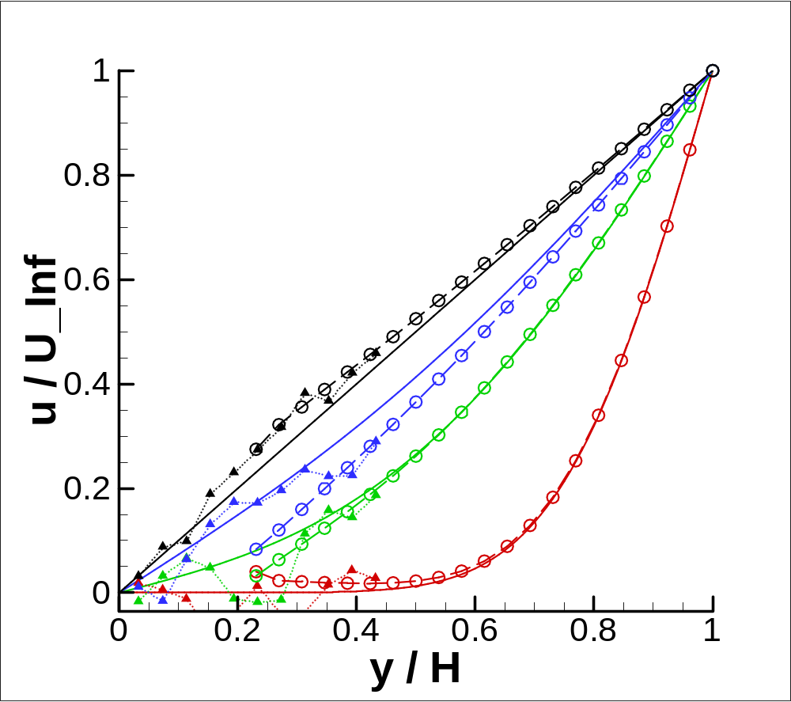
t5
1500τ
200τ
100τ
20τ

Slide 20
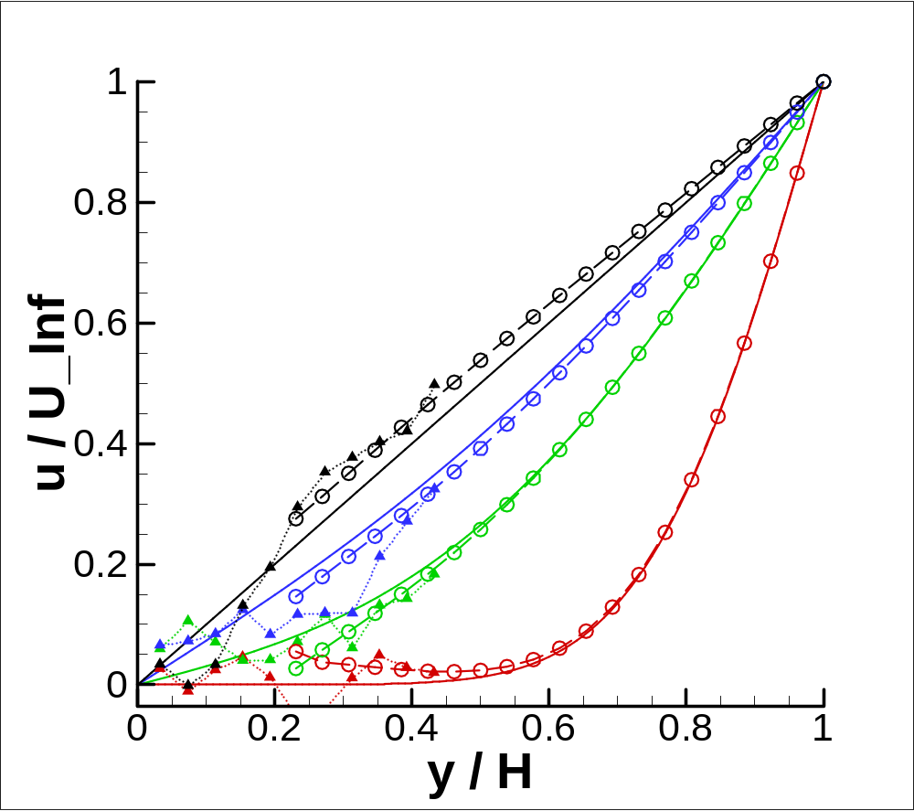
t9
1500τ
200τ
100τ
20τ

Slide 21
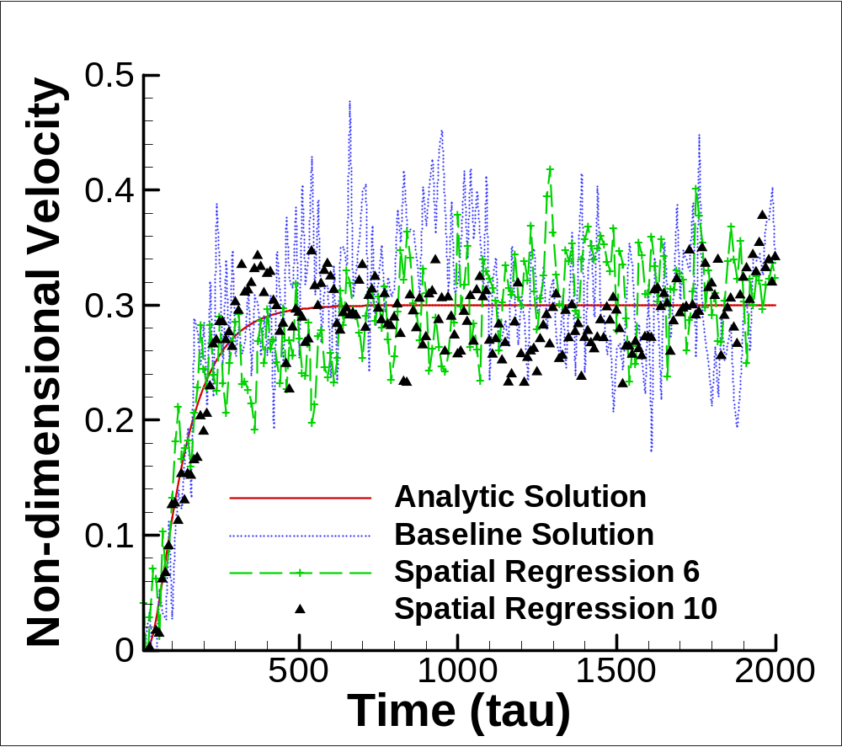
s

Slide 22
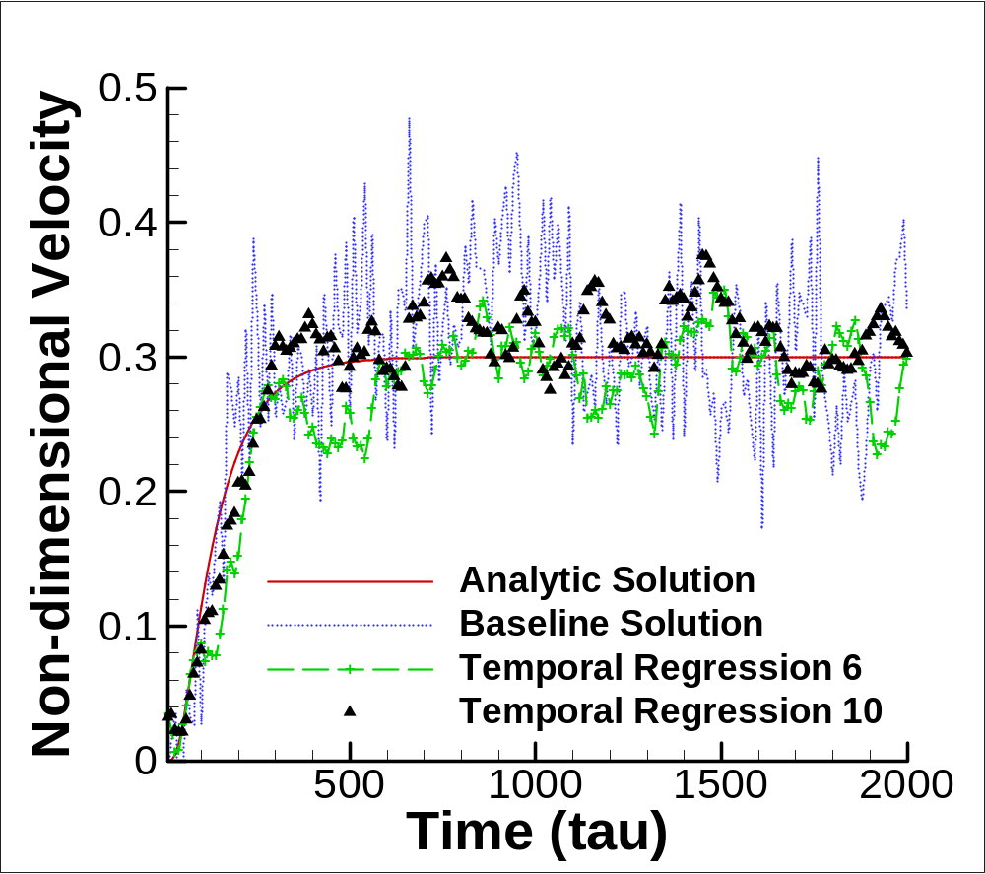
t

