Slide 1
Efficient Replica-Exchange Simulations on Large-Scale Production
Infrastructure
Abhinav Thota
Andre Luckow
Shantenu Jha

Slide 2
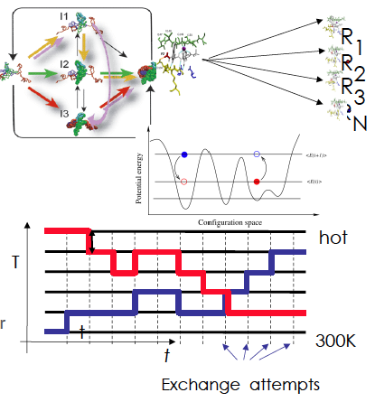
Replica-Exchange Simulations
Replica-Exchange (RE) methods:
  represent a class of algorithms that involve a large number of loosely coupled ensembles.
RE simulations are used to understand a range of physical phenomena.

Slide 3
The Problem
Developing applications that are able to orchestrate heterogeneous resources across distributed resources is a complex task.
RE simulations involve a large number of loosely coupled ensembles.
The challenge is to break the coupling between the development and the underlying infrastructure, to enable RE to be flexible (across infrastructure), extensible (to new methods of communication and coordination) and scalable.

Slide 4
The Solution
We propose a flexible, extensible and scalable implementation of an efficient RE algorithm:
  that can utilize a range of infrastructure concurrently
  that supports different coordination mechanisms
  that supports different replica pairing mechanisms (synchronous versus asynchronous) and thereby different variants of the RE algorithm

Slide 5
Different RE Algorithms
Traditional RE/Synchronous replica-exchange
Asynchronous RE

Slide 6
Traditional (synchronous) RE
For the traditional implementation of RE, depending on the number of replicas (N), the RE manager creates N/2 pairs of replicas.
When all the replicas reach a pre-determined state, the exchanges are attempted (the exchange step).
If an exchange is successful, parameters such as the temperature are swapped and replicas are re-started.

Slide 7
Limitations
The replicas are paired in ﬁxed groups. Exchanges can only take place between these paired replicas:
  inhibits exchanges between replicas with non-nearest temperatures.
Synchronized exchange steps – inefficient with a heterogeneous infrastructure (different running times for each replica).
Synchronized exchange step means large overhead with large number of replicas.

Slide 8
Asynchronous RE
We propose an asynchronous RE algorithm where replicas can perform exchanges asynchronously with any other available replica.
This eliminates the need to pair the replicas and limit exchanges to fixed pairs of replicas.
We present two different implementations:
  Centralized
  Decentralized

Slide 9
Asynchronous RE - Centralized
We propose an asynchronous RE algorithm where replicas can perform exchanges asynchronously with any other available replica.
The replica management is centralized - where a master manages all the replicas.

Slide 10
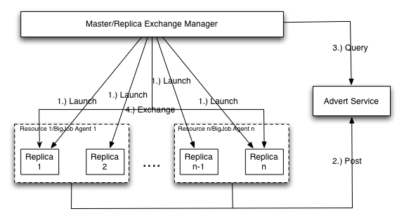
Control Flow

Slide 11
Advantages and Limitations
This is an improvement over the Synchronous RE algorithm.
Scales better with more replicas and distributed resources.
But with large number of replicas, the centralized implementation becomes a bottleneck.

Slide 12
Asynchronous RE – Decentralized
In the decentralized implementation, each replica is handled independently.
This prevents a central manager/master from becoming a bottleneck with large number of replicas.

Slide 13
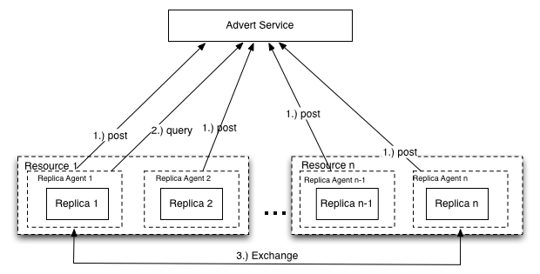
Control Flow

Slide 14
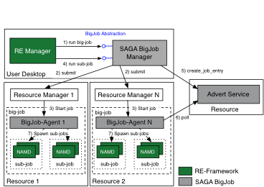
SAGA BigJob Framework
We use the SAGA BigJob (the SAGA Pilot-Job framework) to run RE simulations across multiple, heterogeneous distributed Grid infrastructures.
(Application)

Slide 15
Comparison
We have implemented the following:
  Synchronous RE
    Case I: Synchronous (traditional) RE
  Asynchronous RE
    Case II: Asynchronous RE (centralized)
    Case III: Asynchronous RE (decentralized)

Slide 16
Results
(on LONI/Teragrid resource QueenBee)

Slide 17
Configuration
We configured the traditional and asynchronous RE (both centralized and decentralized) to run a parallel NAMD simulation with 4, 8, 16, 32 and 64 replicas sampling a temperature between 300 K and 1000 K on QueenBee.
Each replica uses 16 MPI processes and runs 500 time steps between exchange attempts. Therefore in each case a single BigJob is launched with sufficient number of cores. The metric used is the time to complete a particular number of exchanges.
The ratio between the number of replicas and the number of exchanges is kept constant, for the purpose of comparison.

Slide 18
Analysis
As the ratio between the number of replicas and the number of exchanges is kept constant, ideally, the runtime must be constant too.
But with an increase in the number of replicas, the performance deteriorates.
The Logic behind synchronous and asynchronous RE inevitably influences the implementation and the consequent performance.
In synchronous RE, the overhead of managing a large group of replicas at each exchange step causes the degradation.
Asynchronous RE scales better with a large number of replicas and resources.
And the decentralized asynchronous RE beats the centralized version.
Notes:
It is possible to design a decentralized synchronous RE mechanism.
But then, with a heterogeneous infrastructure, each replica could have different run times.
The asynchronous RE mechanism eliminates the synchronization delays caused due to a heterogeneous infrastructure.
A decentralized implementation adds to the efficiency of the asynchronous RE method.

Slide 19
Results
(distributed over Teragrid resources Ranger and QueenBee)

Slide 20
Questions/Comments

